Slide 1

Entity Framework CORE 6
Sit Dolor Amet

Slide 2
First Application using EF CORE

Slide 3
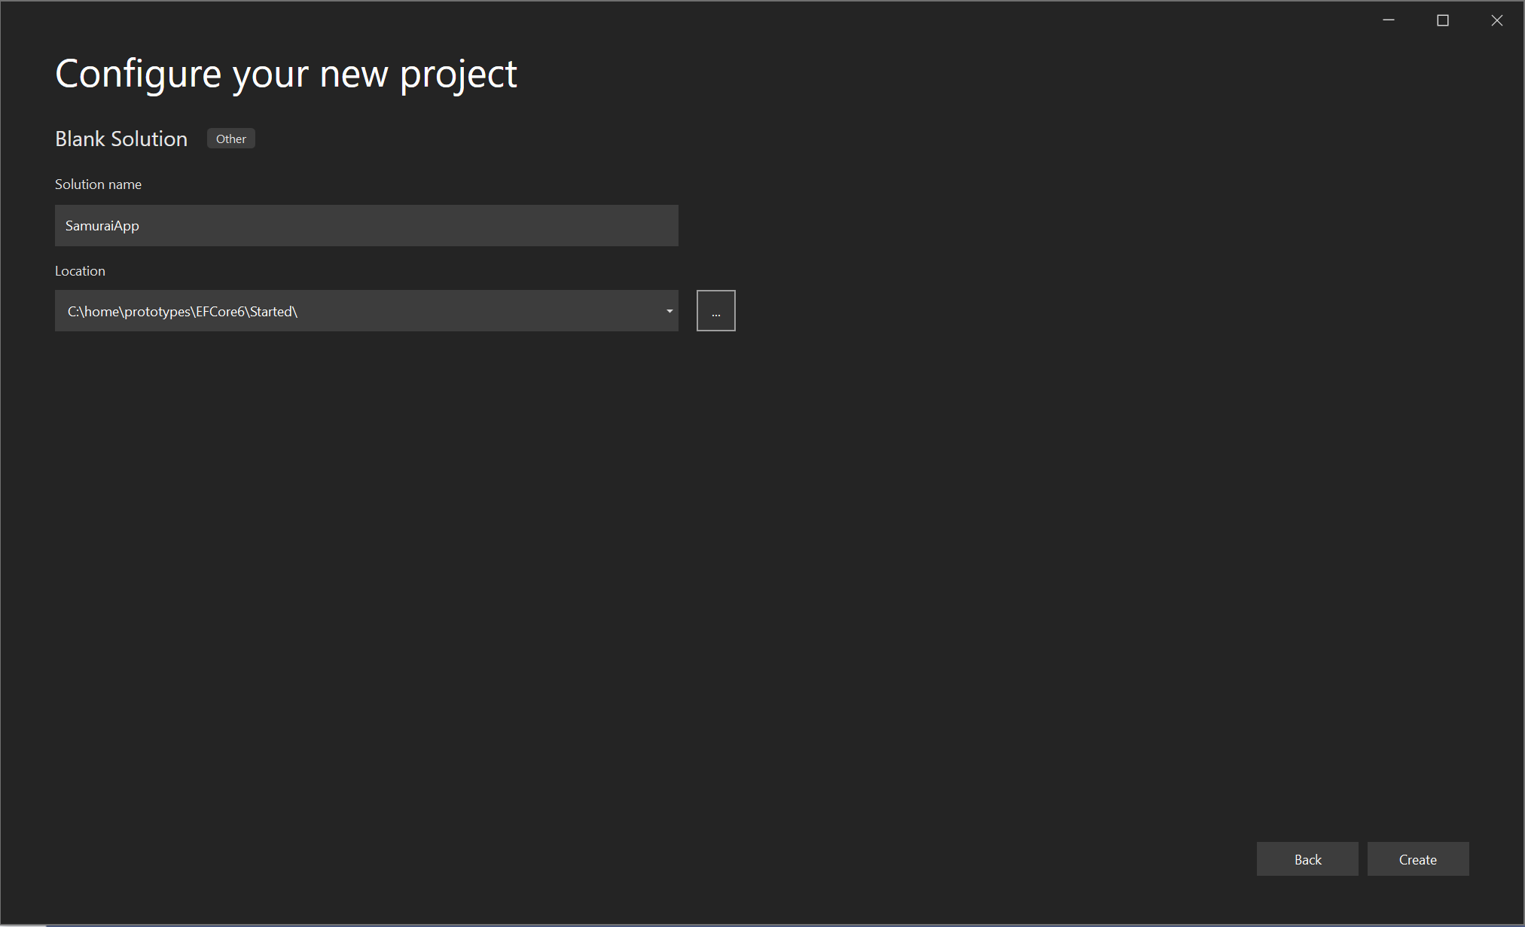
Blank solution

Slide 4
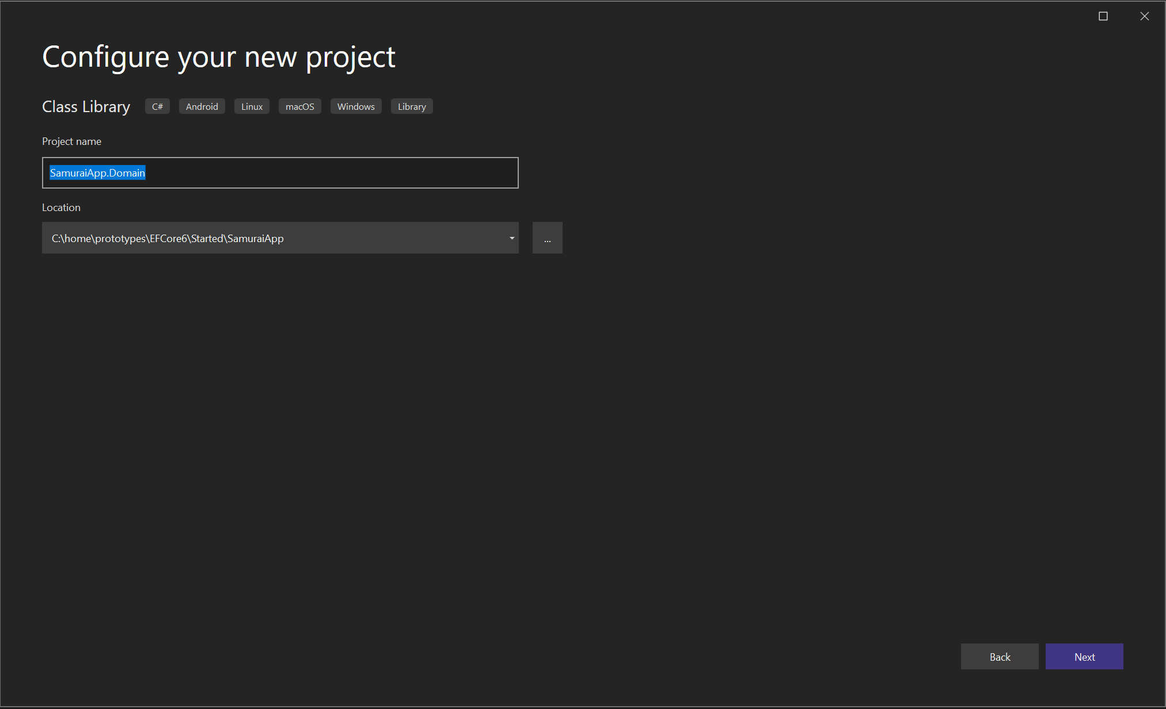
Create domain classes

Slide 5
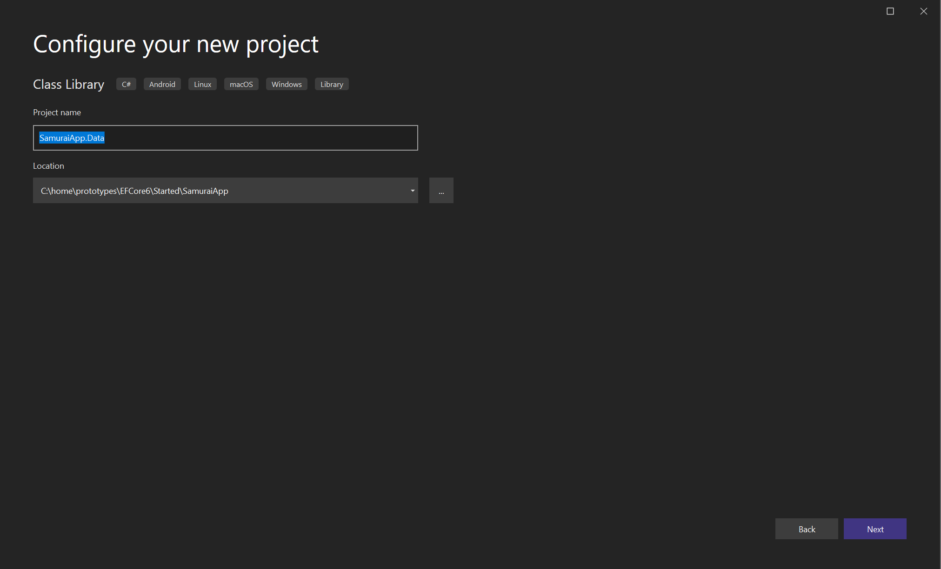
DATA

Slide 6
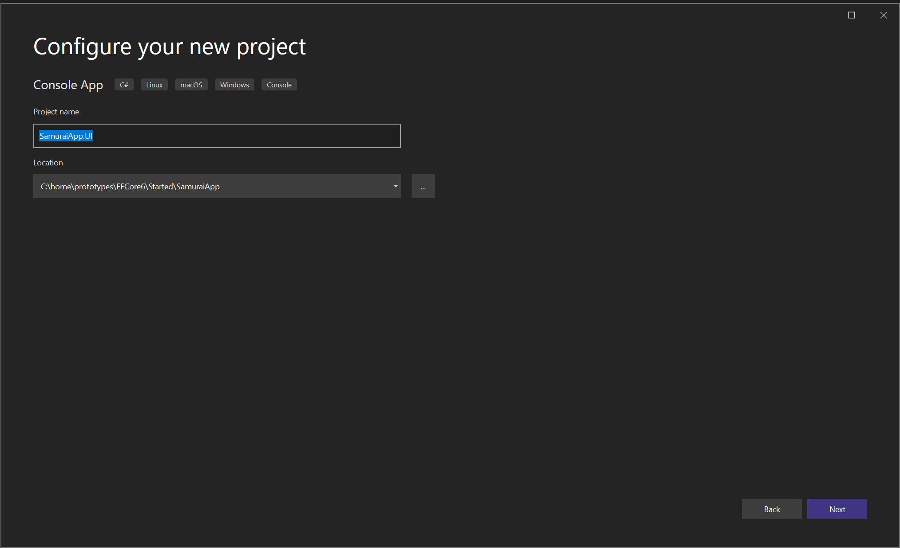
UI

Slide 7
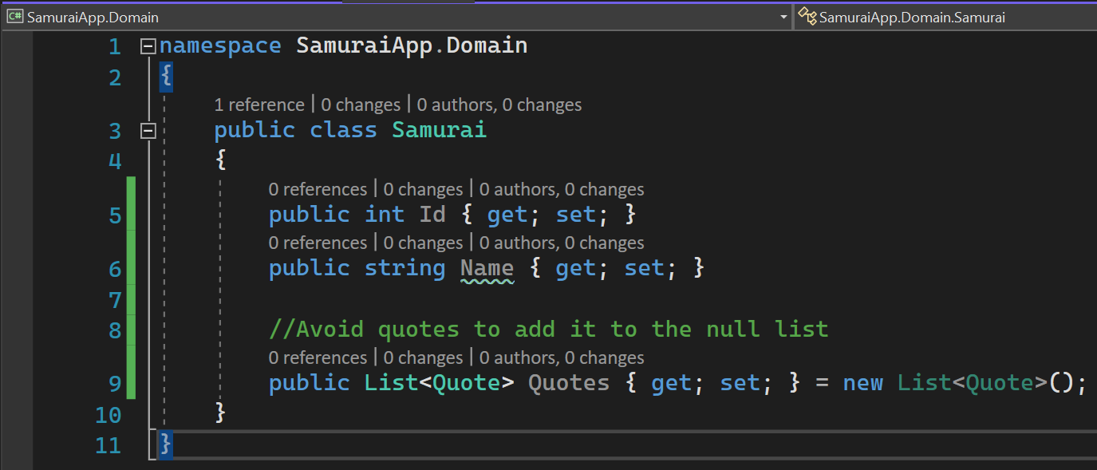
Domain class samurai

Slide 8
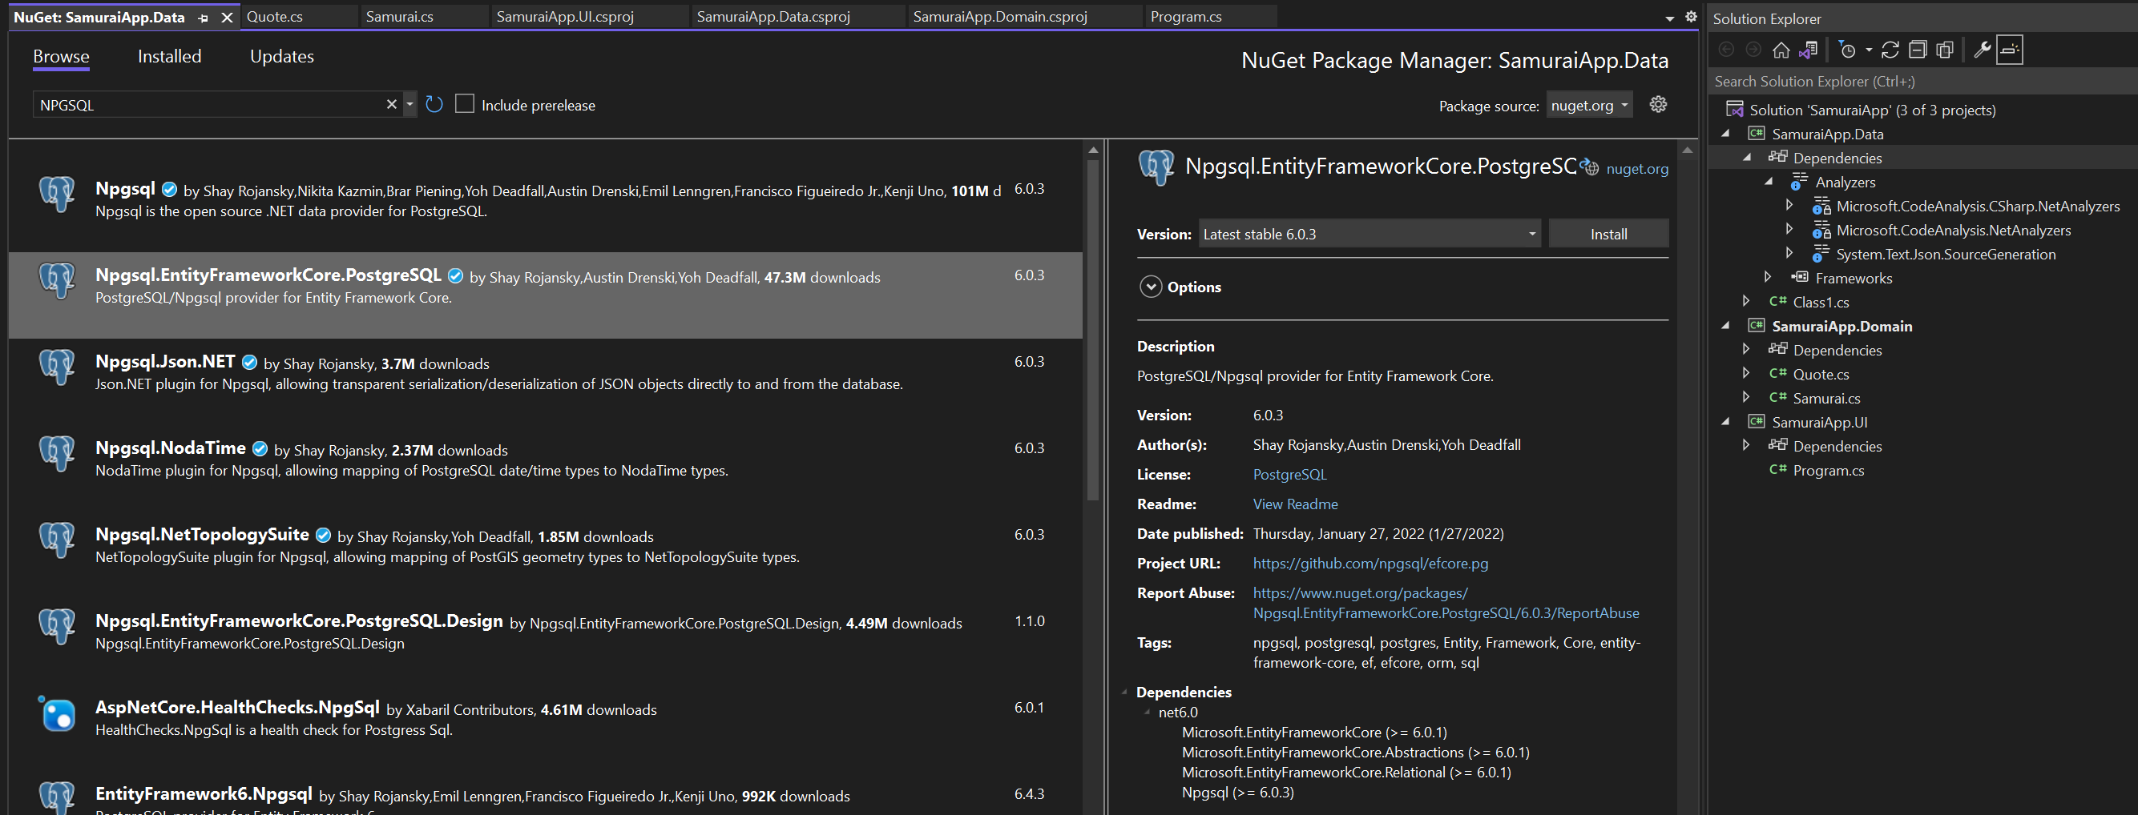
EF CORE

Slide 9
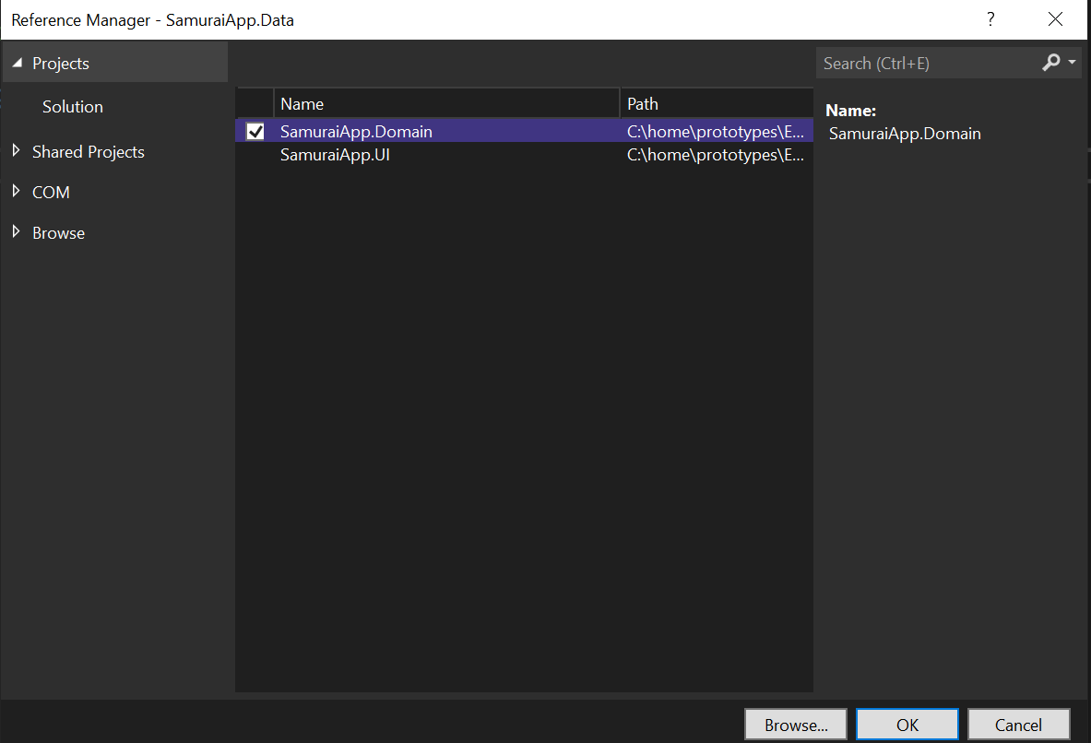
ADD PROJECT REFERENCE

Slide 10
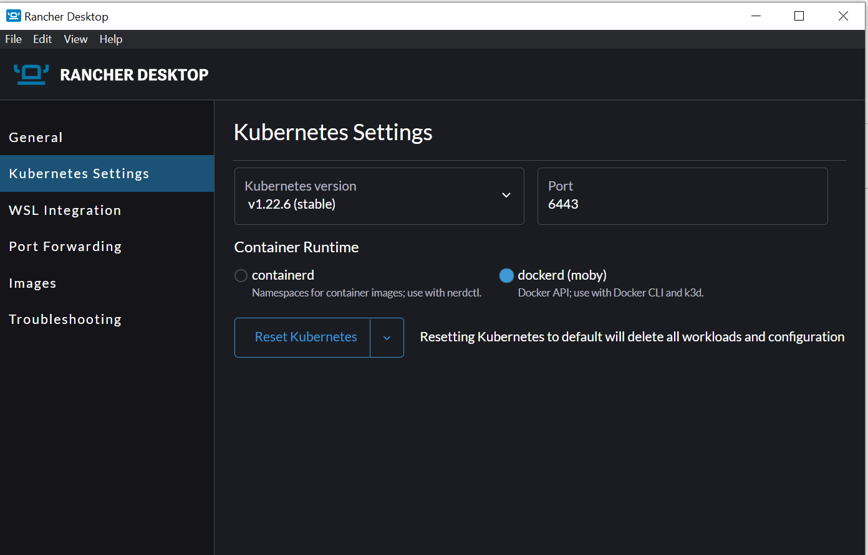
Install rancher
docker run --name postgres_proto -e POSTGRES_PASSWORD=sandeep -p 5435:5432 -d postgres

Slide 11
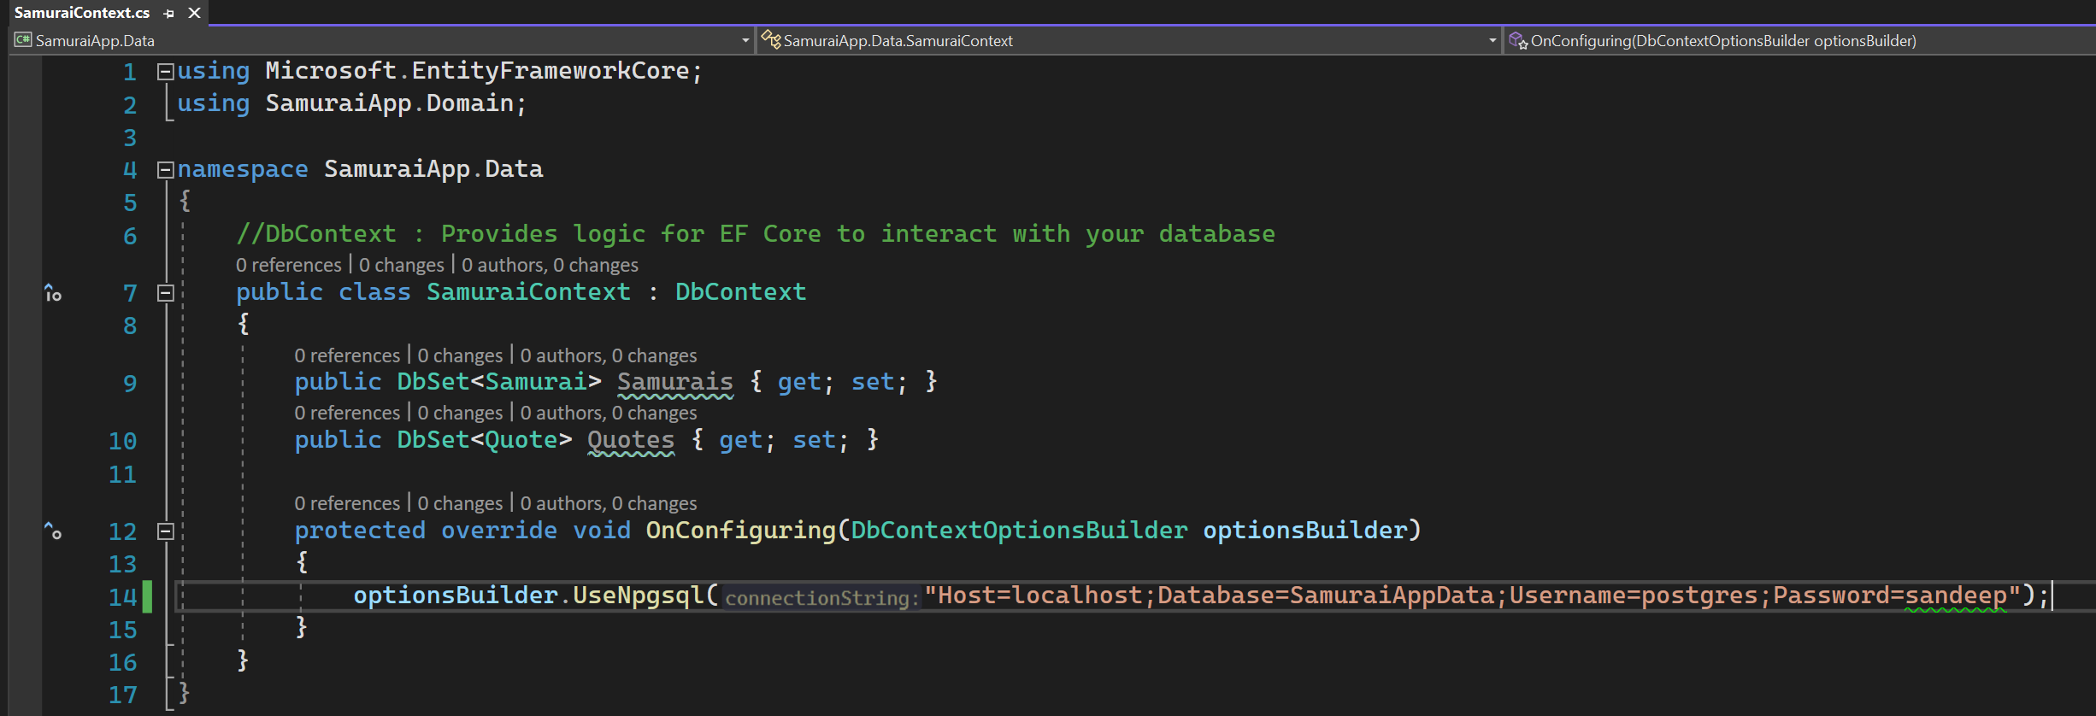
Samurai context

Slide 12
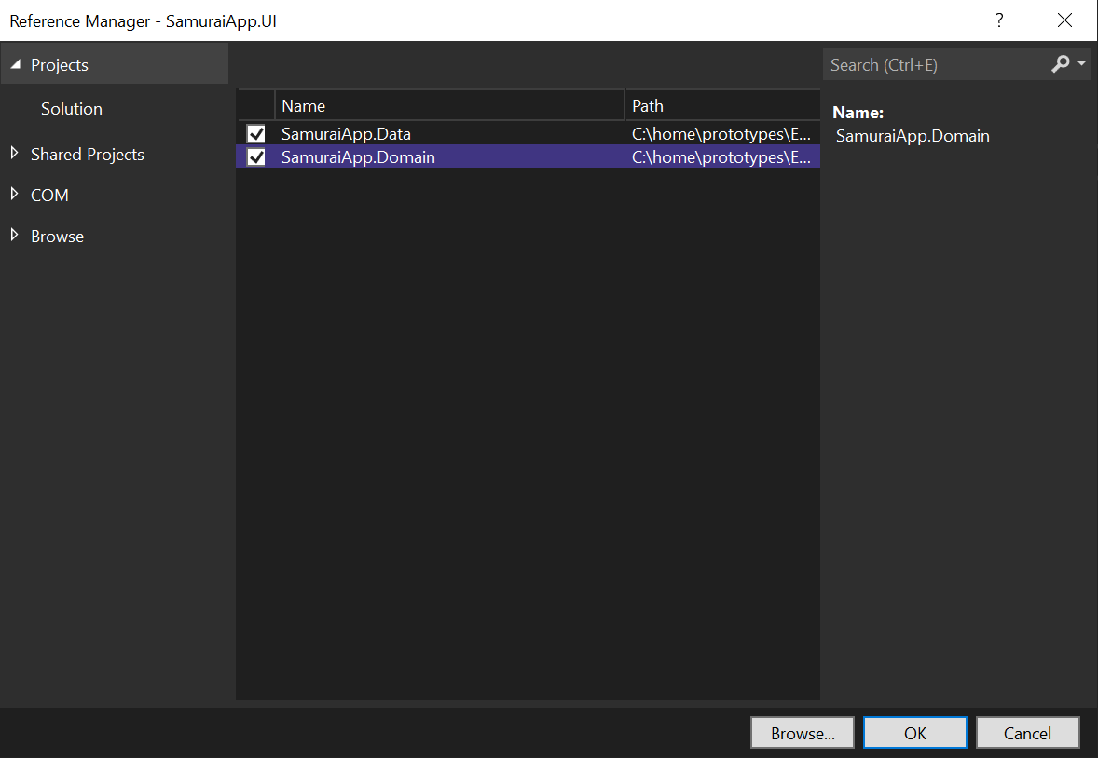
Adding context

Slide 13
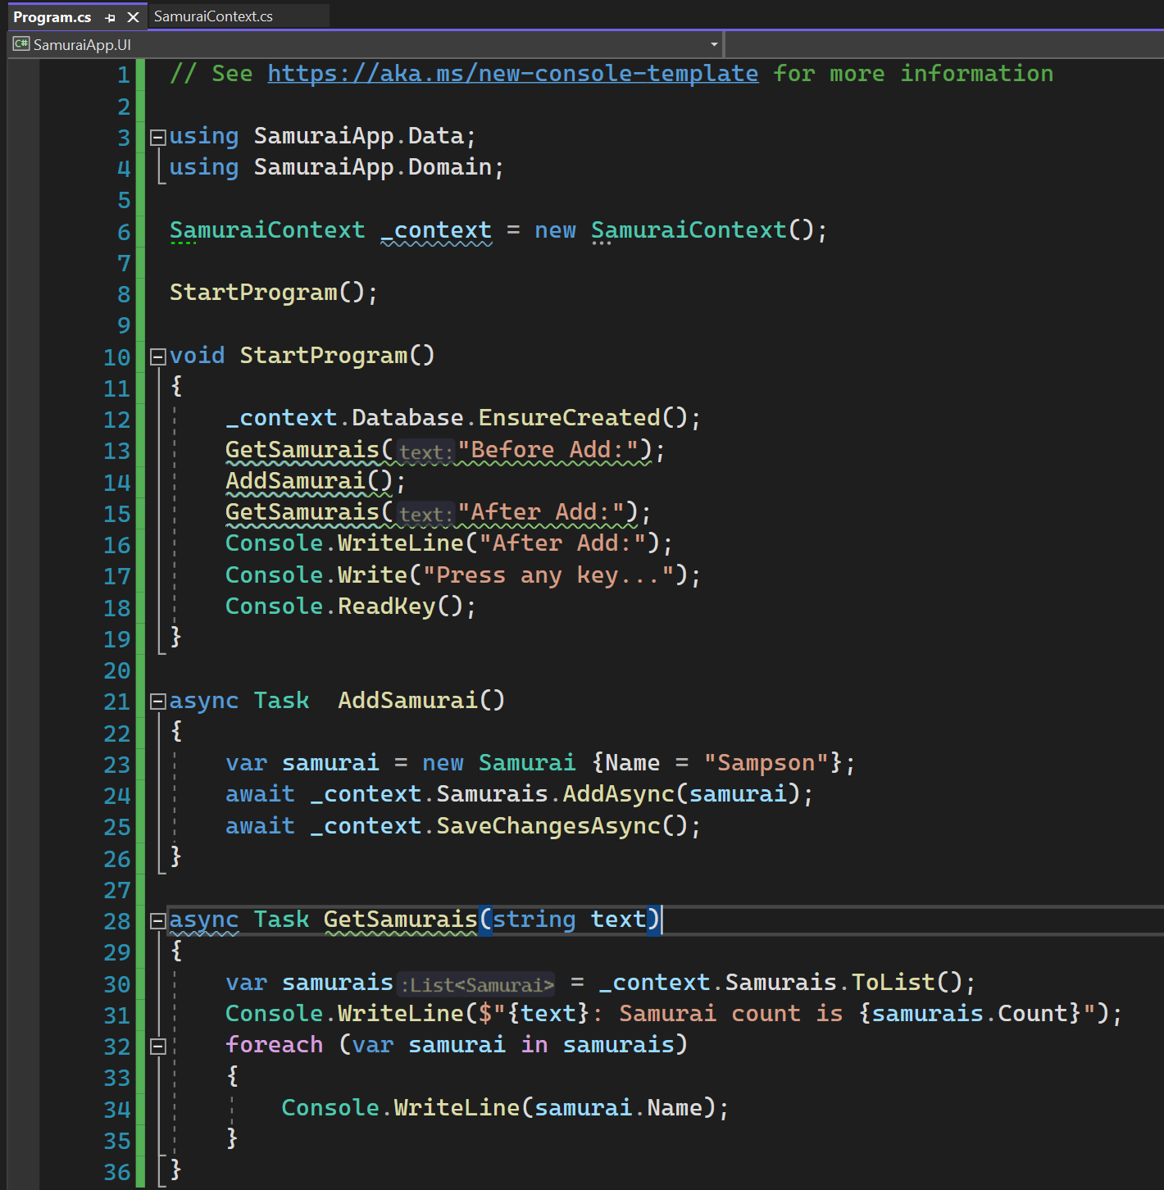
SAMURAI UI

Slide 14
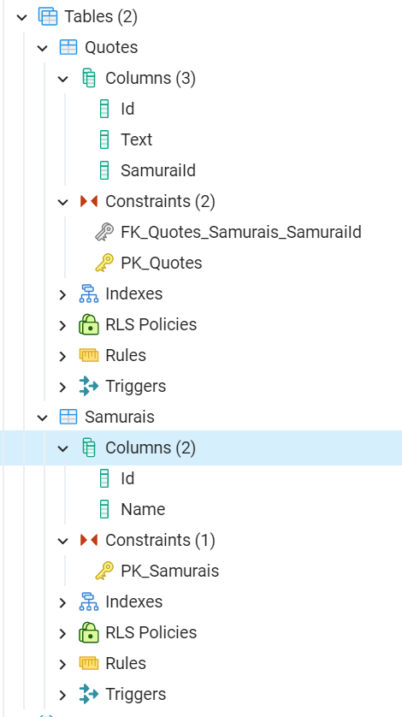
Constraints

Slide 15
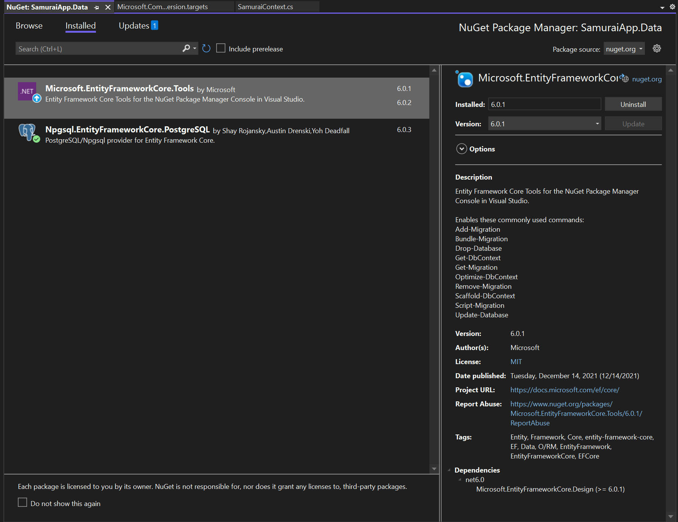
Add Microsoft.entityframework.core.tools

Slide 16
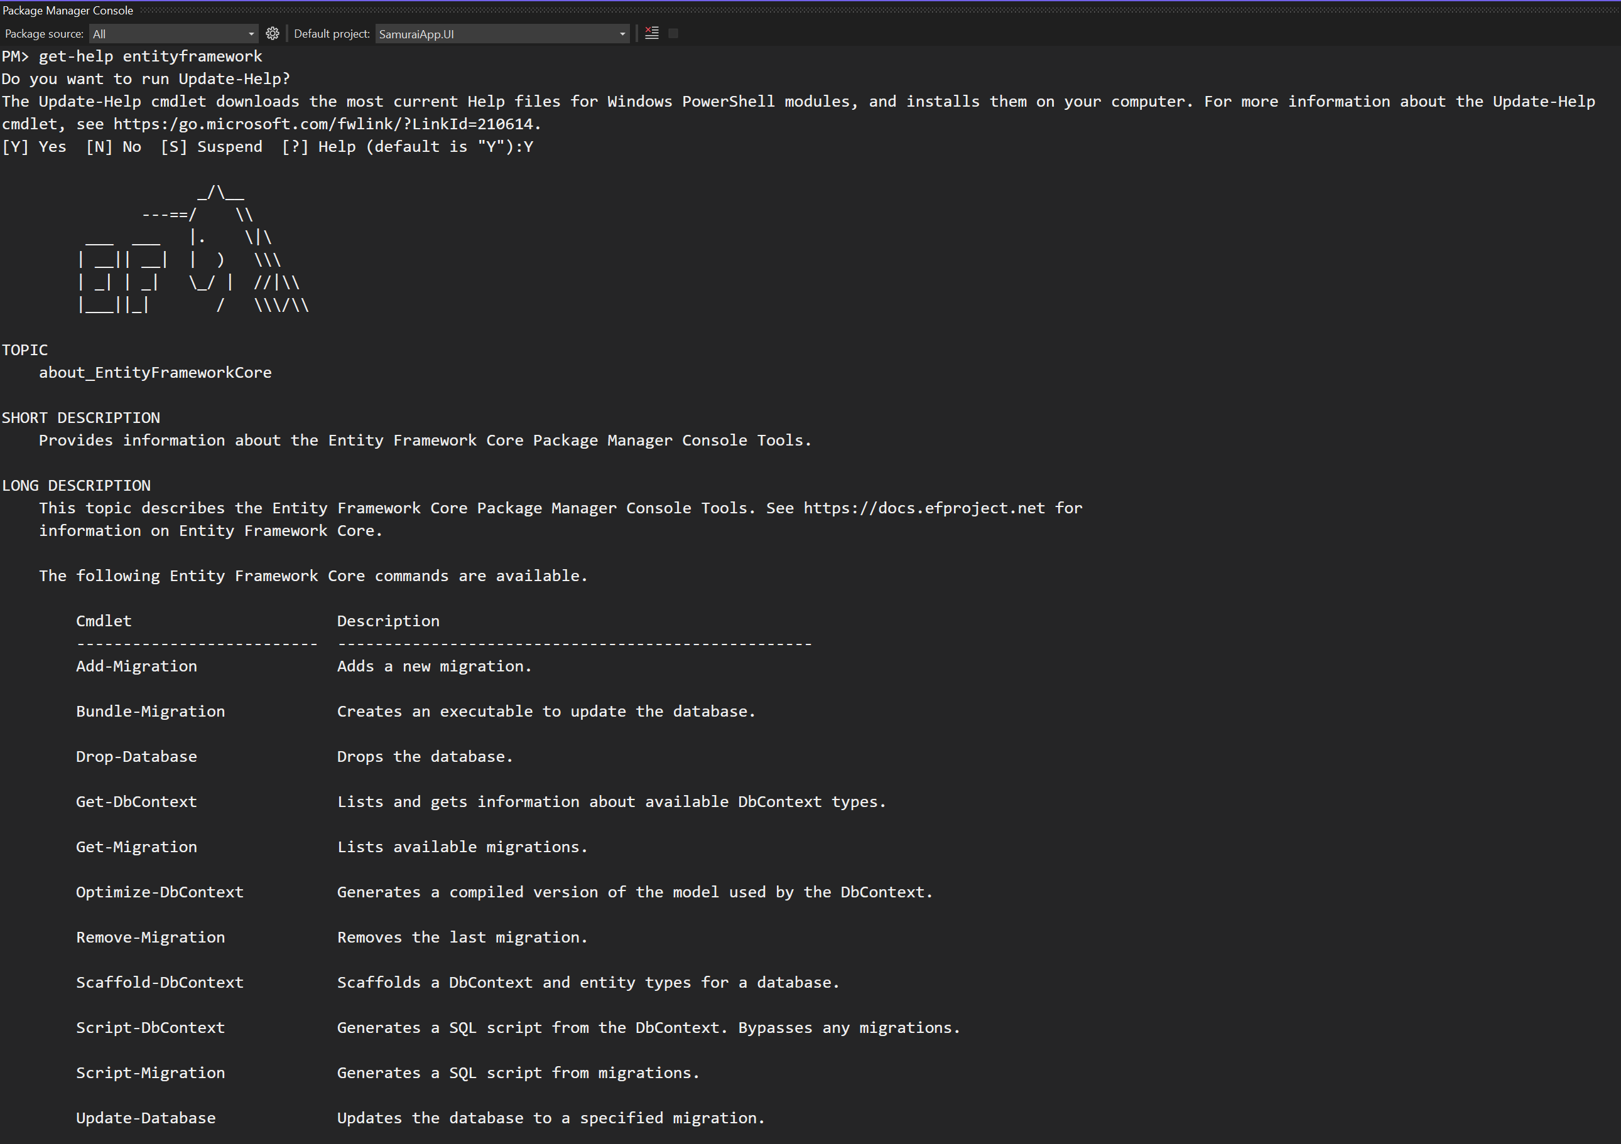
Get-help entity FRAMEWork - 1

Slide 17
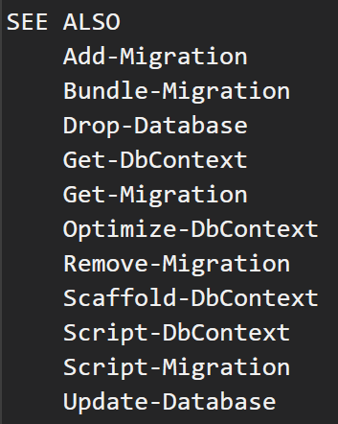
Get-help entity Framework - 2

Slide 18
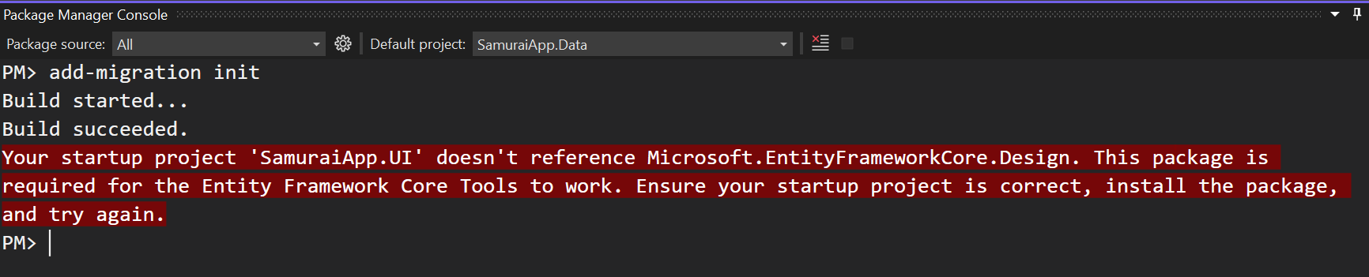
Get-help entity Framework - 3

Slide 19
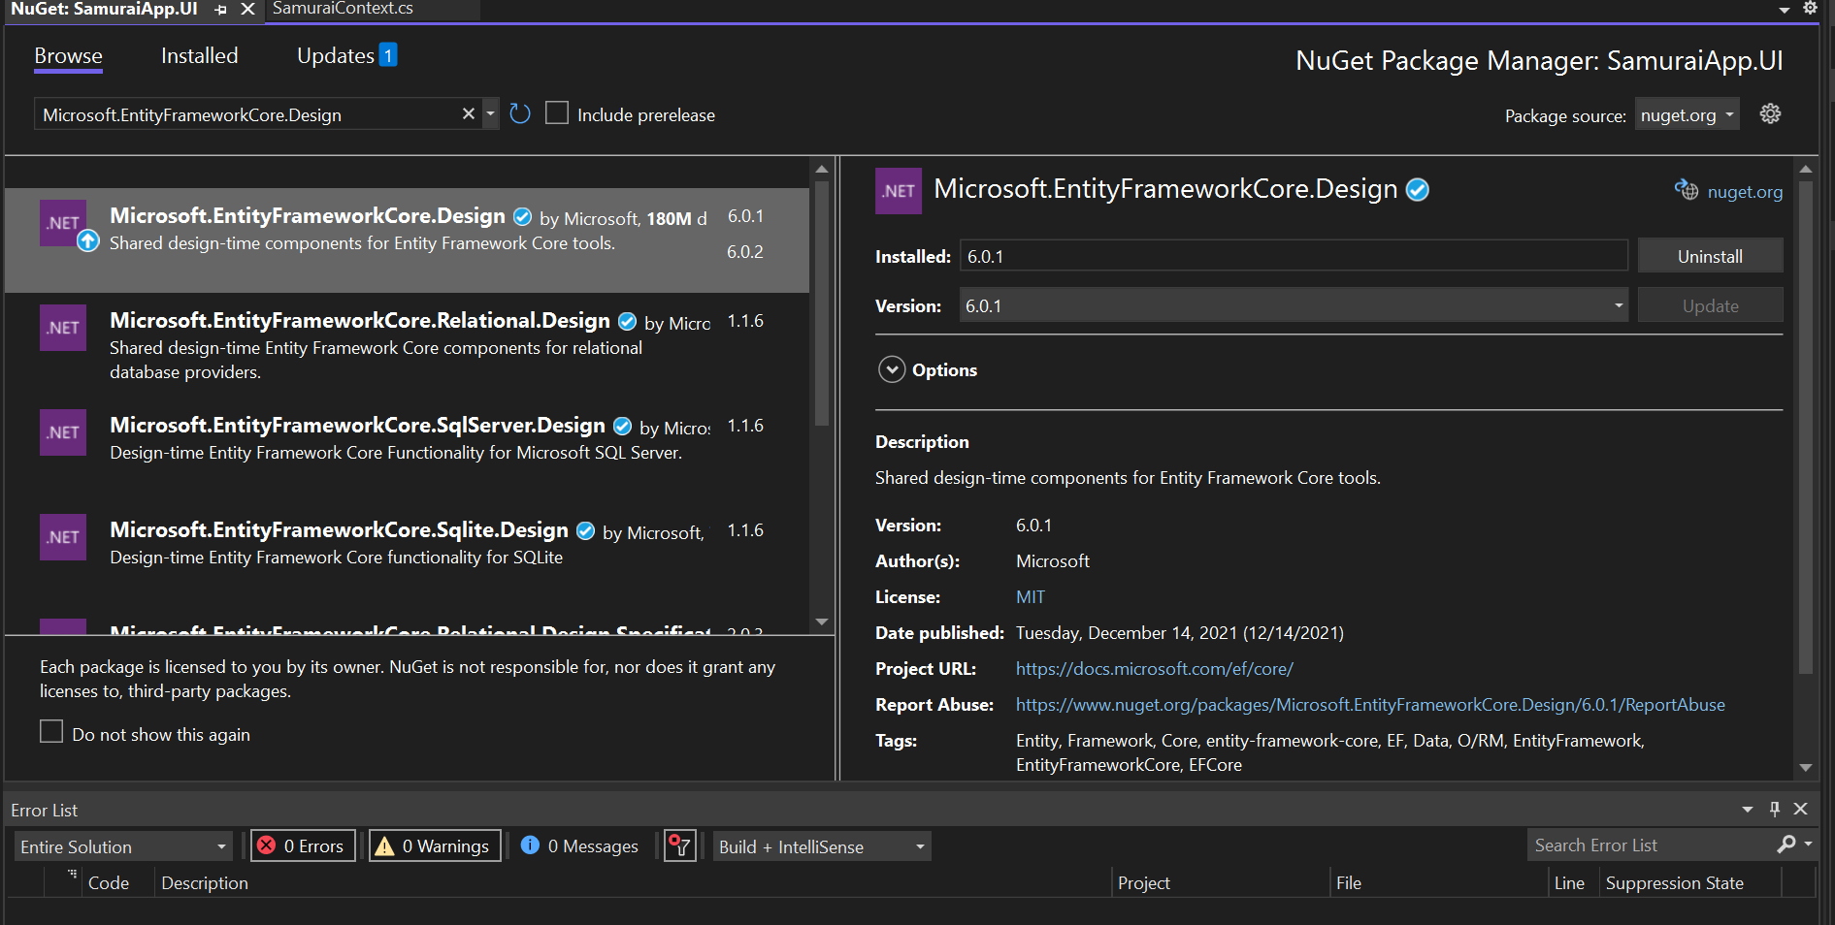
Add in the UI

Slide 20
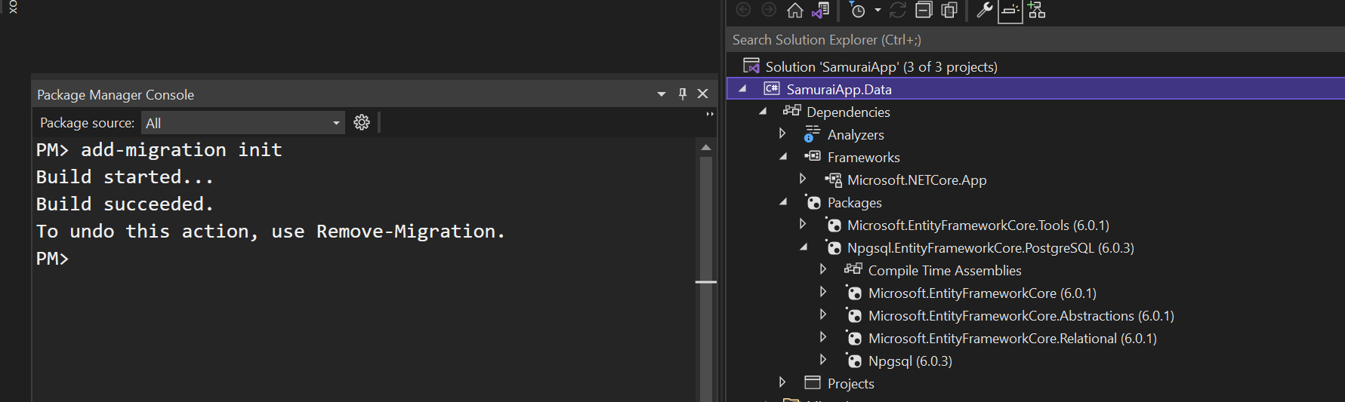
Add migration

Slide 21
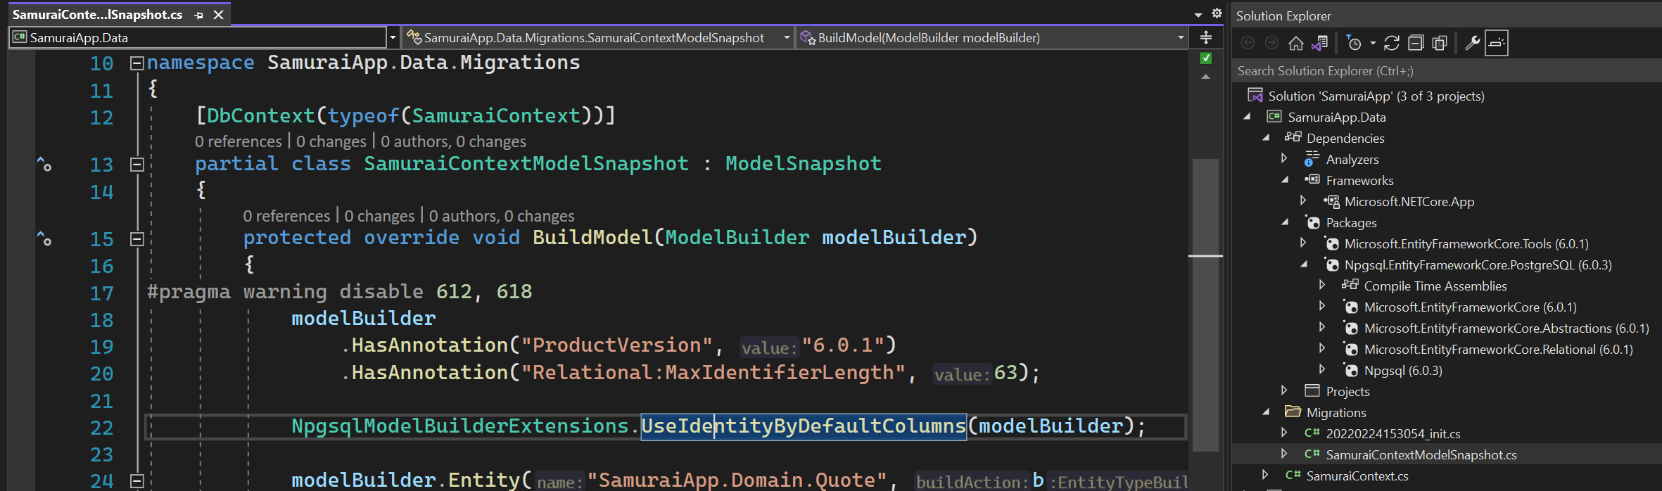
Snapshot
The snapshot is used to determine how to migrate from one model version to next.

Slide 22
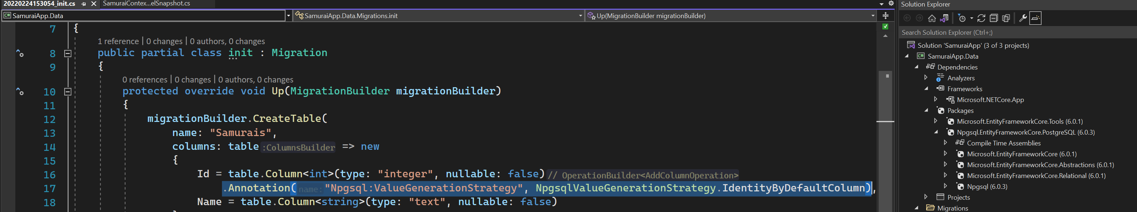
Migration code - Identity column

Slide 23
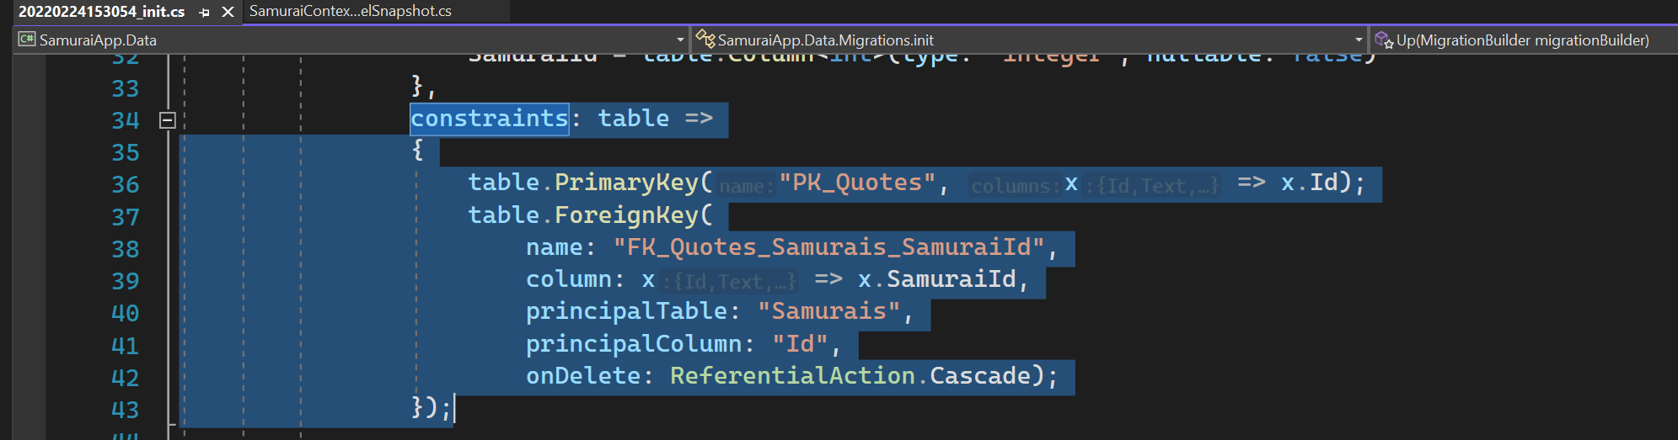
Migration code - constraints
EF Core recognized one to many relationship

Slide 24
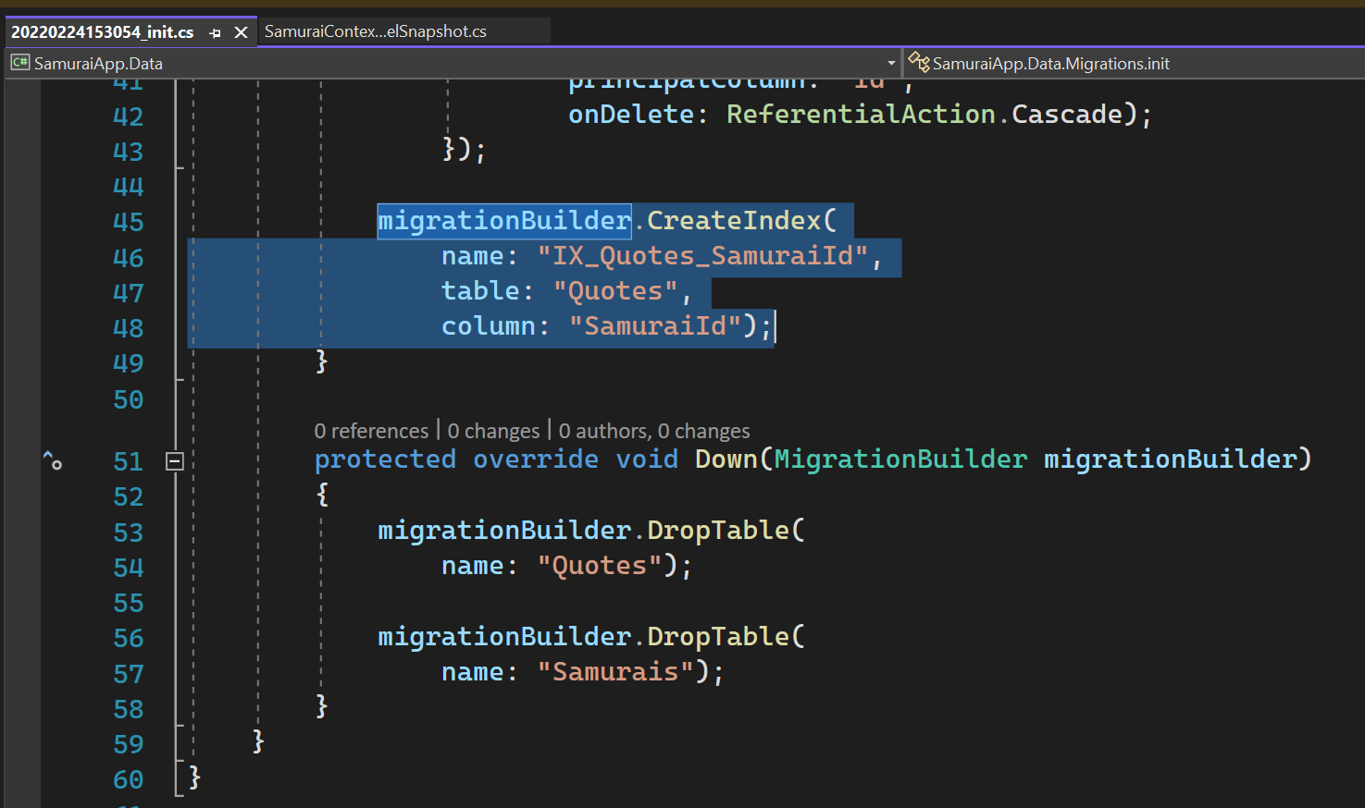
Migration code - index
Create index for foreign key that discovers on the model.

Slide 25
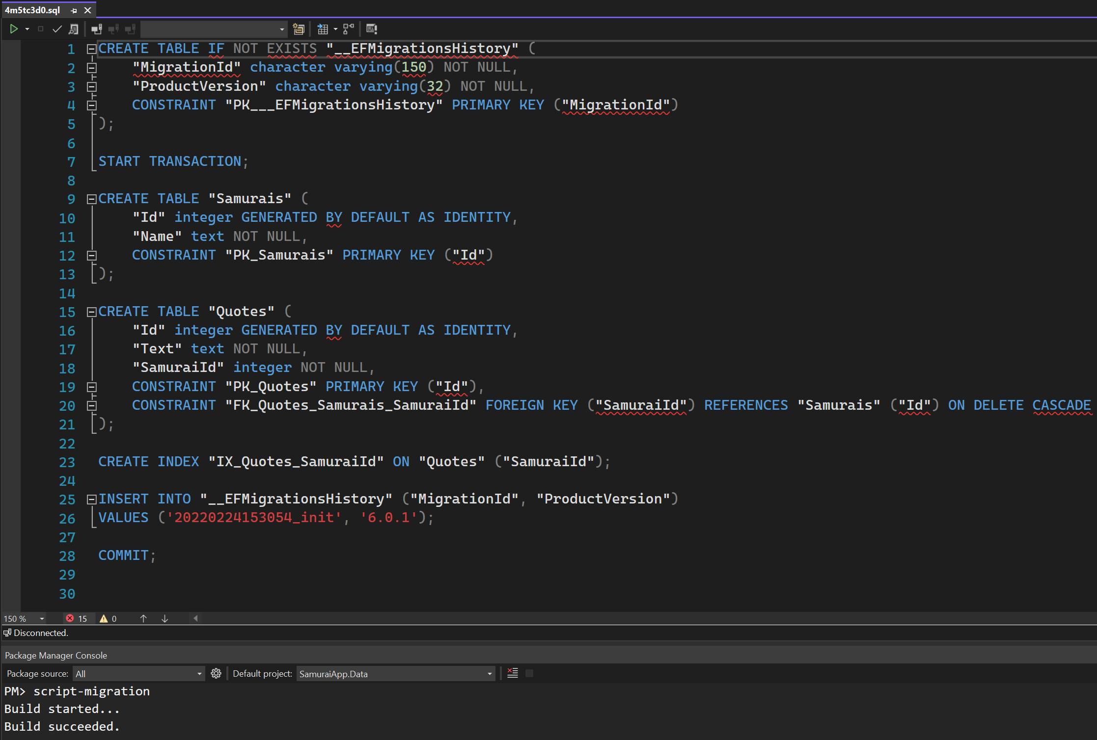
Script migration

Slide 26
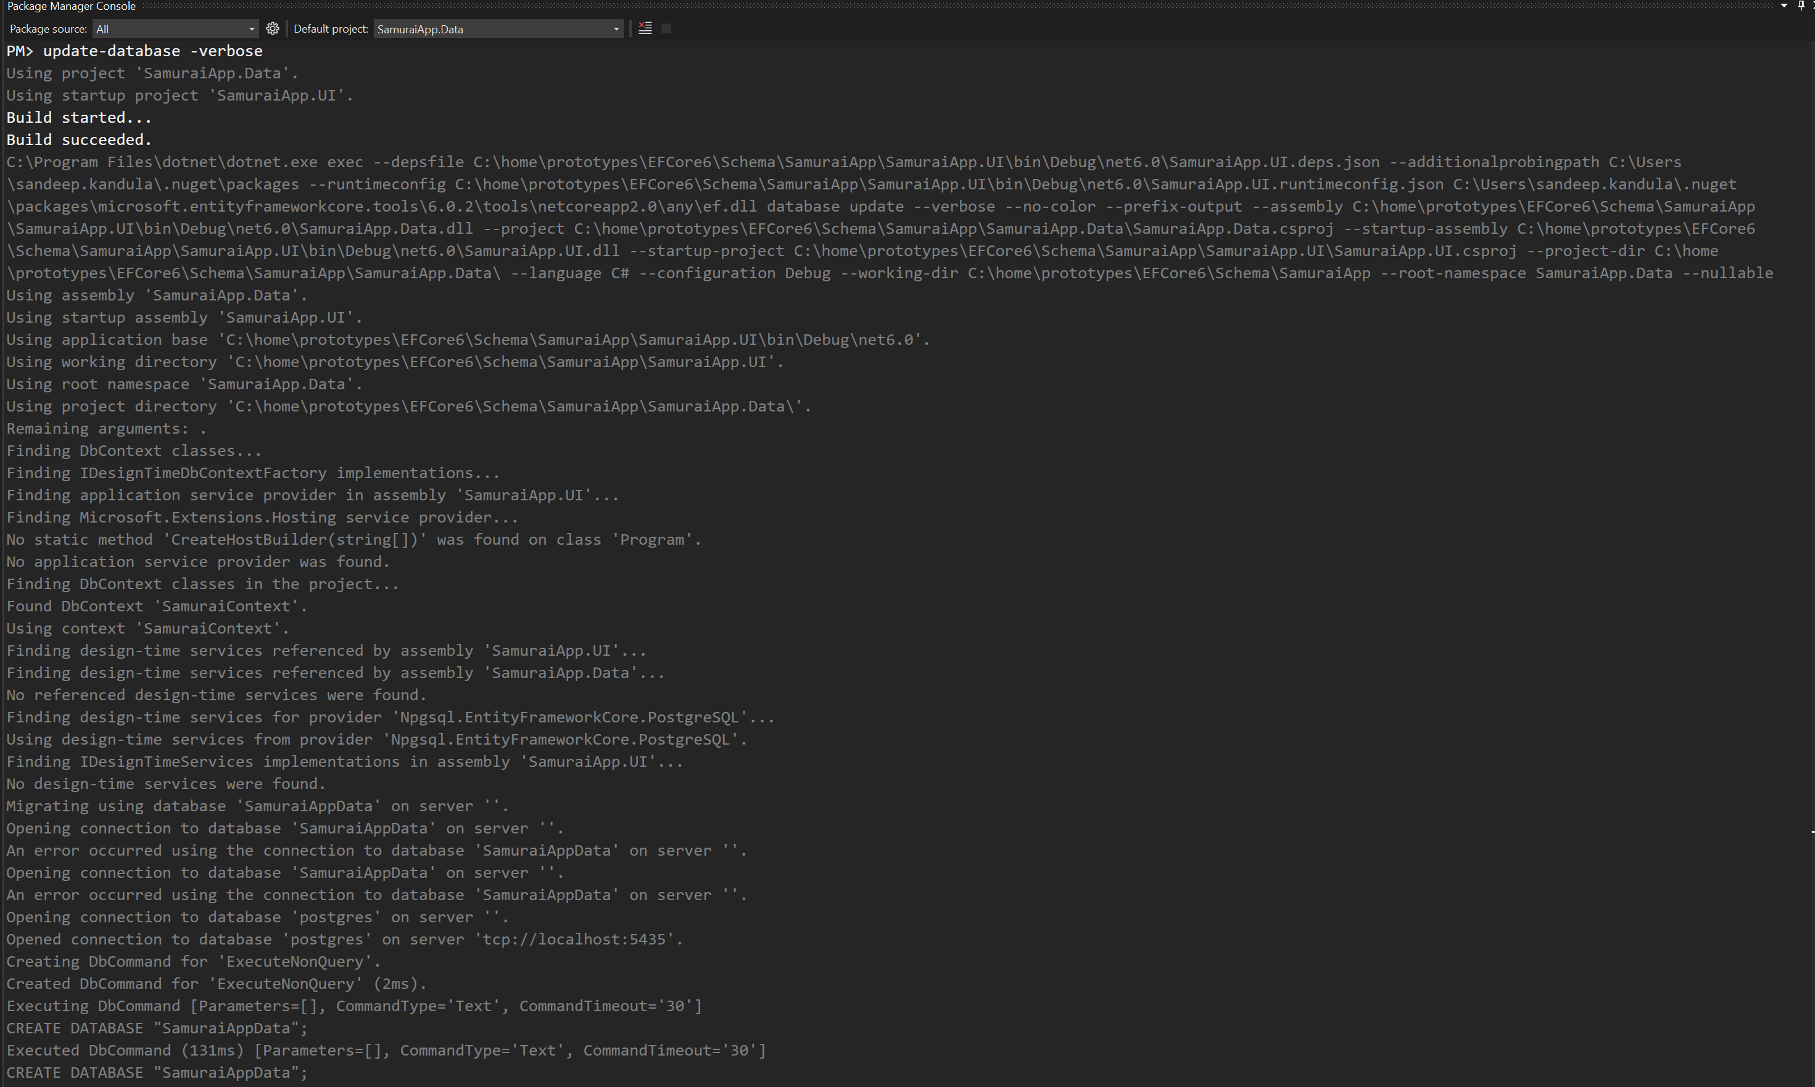
Update-database

Slide 27
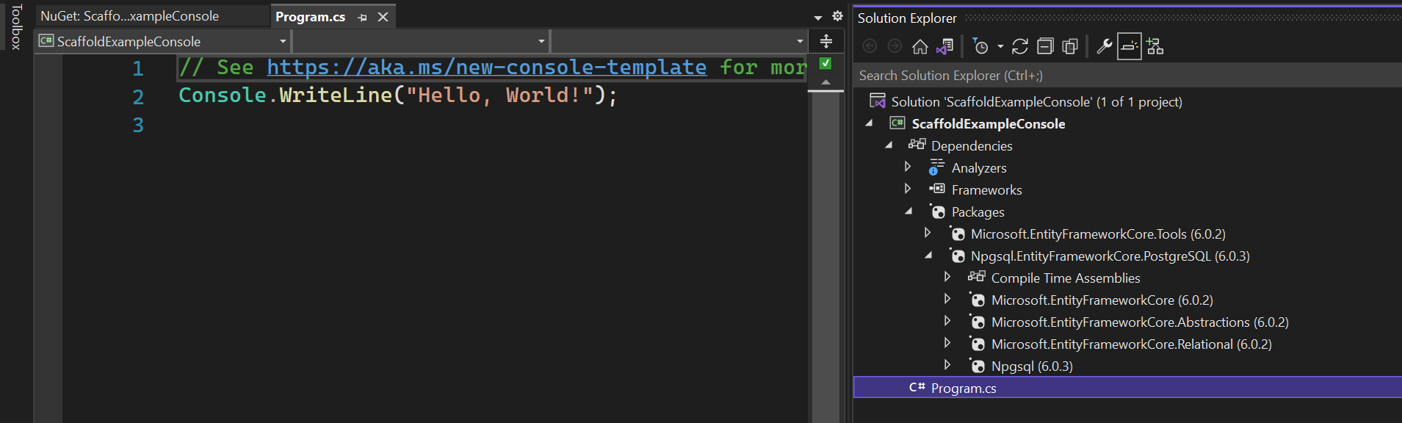
ReverSe engineer an existing database - 1
https://cmatskas.com/ef-core-migrations-with-existing-database-schema-and-data/

Slide 28
ReverSe engineer an existing database - 2
https://cmatskas.com/ef-core-migrations-with-existing-database-schema-and-data/

Slide 29
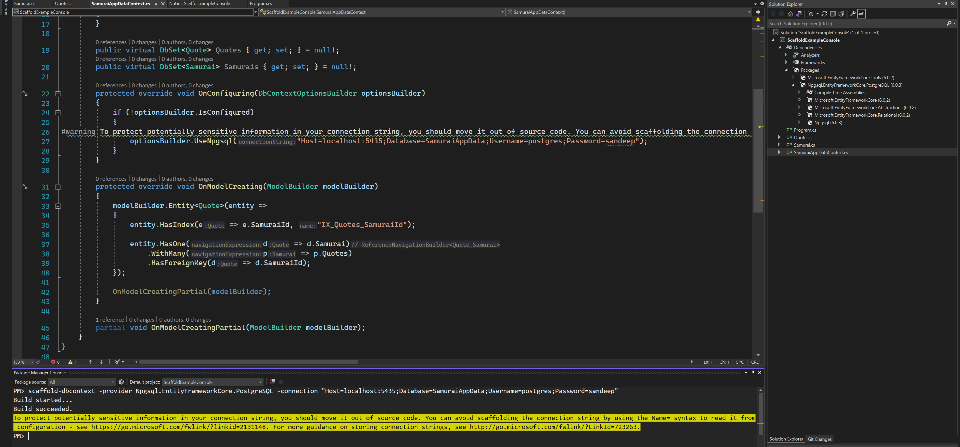
ReverSe engineer an existing database - 3

Slide 30
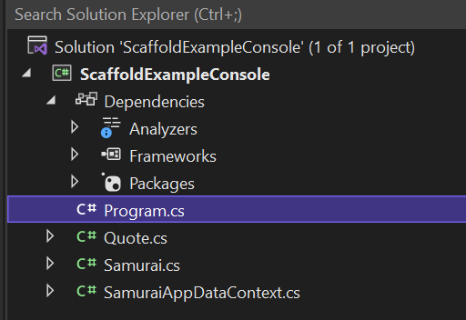
EF Core 6
EF Core 6 scaffolding now defaults to creating singular names for the entity classes.

Slide 31
ExTRAS

Slide 32
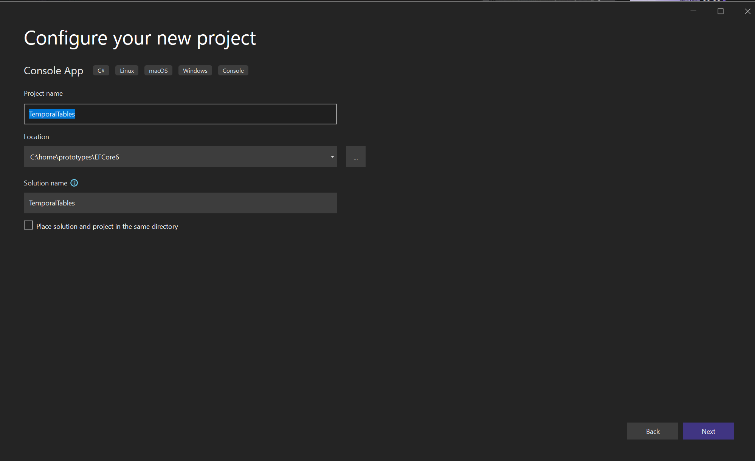
Temporal tables

Slide 33
dotnet

Slide 34
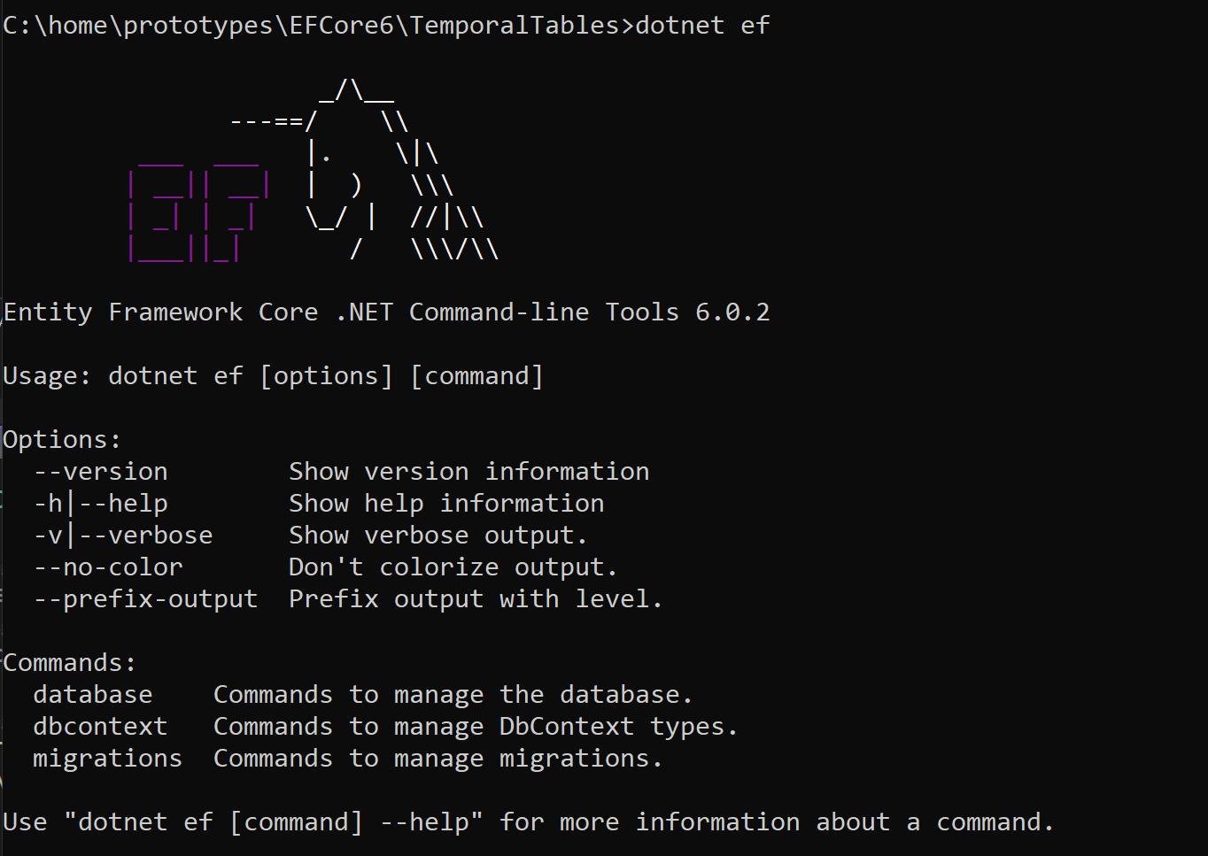
Dotnet tool

Slide 35
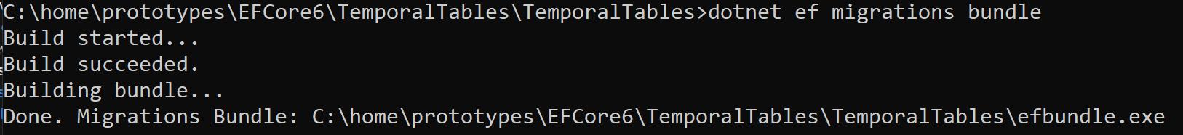
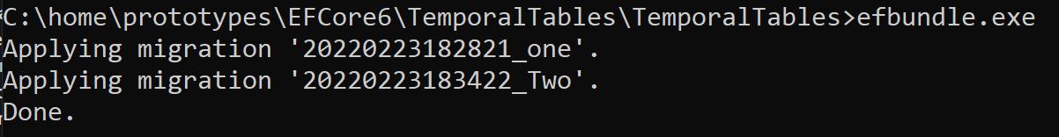
Migration bundle

